Slide 1



General Information on Professional Internship
Made by:
Barbara Masa
GTK Career Office
Student Coordinator
Szeged, 10 March 2025
Notes:
I would like to present in a few words the course of the internship procedure. If you are TAC (Tourism and Catering) students you will meet me about your internship in your, 7th or 8th semester. I also included student questions in my presentation. If you have any questions, you can write an e-mail me.

Slide 2


General Information on Professional Internship
Website: https://u-szeged.hu/sztekarrier/hallgatoknak-for/information-in-english
Address: 6722 Szeged, Vitéz street 17. (Career Office;
Office 8)
Your name
City,
Street, house number, floor
Postcode
Karrier Iroda
Masa Barbara részére
Szeged,
Kálvária sgt. 1.
6722
Notes:
You don't look for me in the main building. My address is Vitéz street 17, office 8.
My postal address and Career Office aren’t in the same place.
In this picture you can see how to write an envelope. Write me an e-mail if you will send me the documents by post.

Slide 3

General Information on Professional Internship
Telephone number: +36 30 121 13 53
E-mail address: masa.barbara@szte.hu
Opening hours:
You have to make an
appointment with me
for personal meeting.
Saturday
Sunday
Always identify yourself!
Name, major, etc.
Notes:
You can see here the details of the GTK Career Office:
- My phone number,
- My e-mail address,
- My opening hours.
If you write an e-mail to me please always identify yourself!

Slide 4


First questions
I have any questions about the final exam or the thesis.
Can I make an appointment on Saturday?
Dear TAC students!
Contact me about the internship course!
Notes:
First questions
I can help you only about the compulsory professional internship course. If you have any questions about the final exam or the thesis, please contact Gabriella Maczkó, not me.
You can’t make an appointment on Saturday. You can do it on the opening hour.

Slide 5
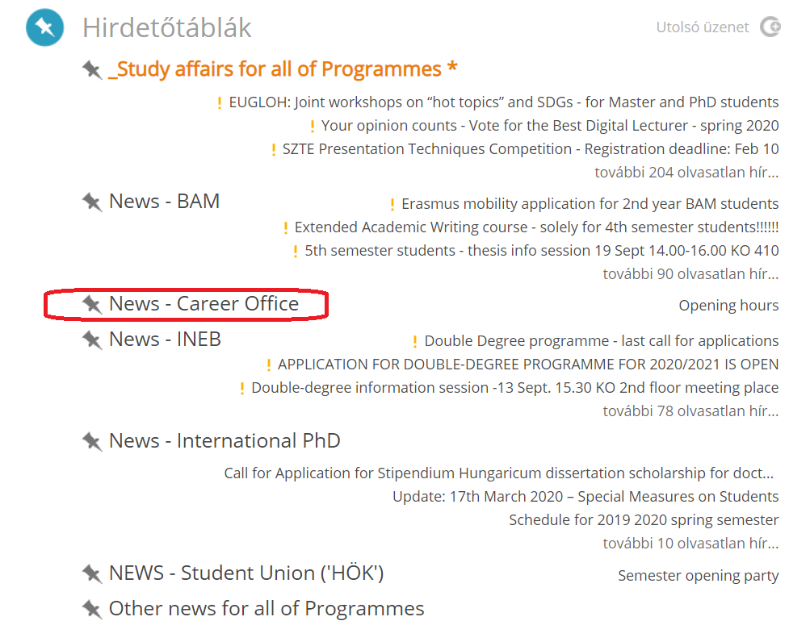
GTK General Information Study Affairs
CooSpace
Notes:
Follow the Career Office news on the CooSpace scene in the GTK General Information Study Affairs Folder. I usually write about changes, internship positions and job offers. This is where you get up to date information.

Slide 6
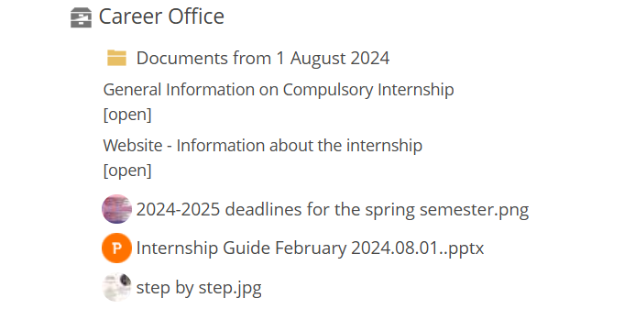
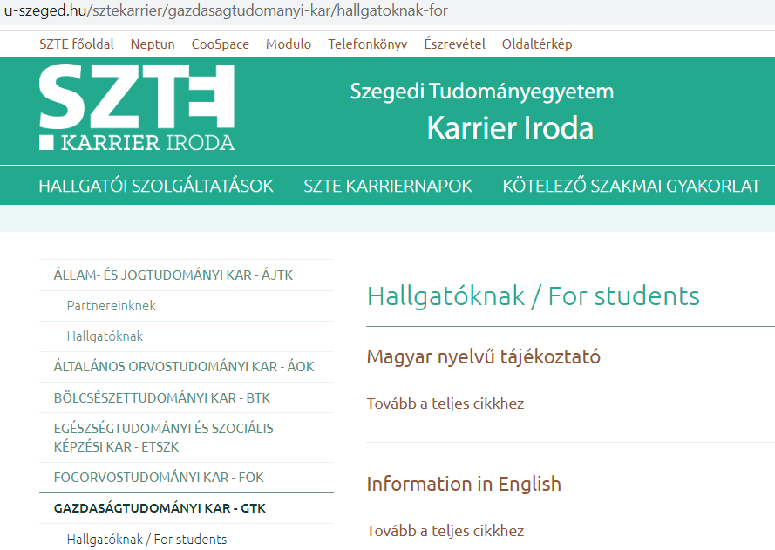
Downloadable documents
CooSpace
On our website
https://u-szeged.hu/sztekarrier/hallgatoknak-for/information-in-english
Notes:
You can download the documents from two different webpages.
Follow the Career Office on the CooSpace scene in the GTK General Information Study Affairs Folder.
You can download the documents on our website too. It is a Hungarian website, but you can find English information in the sub folder.

Slide 7

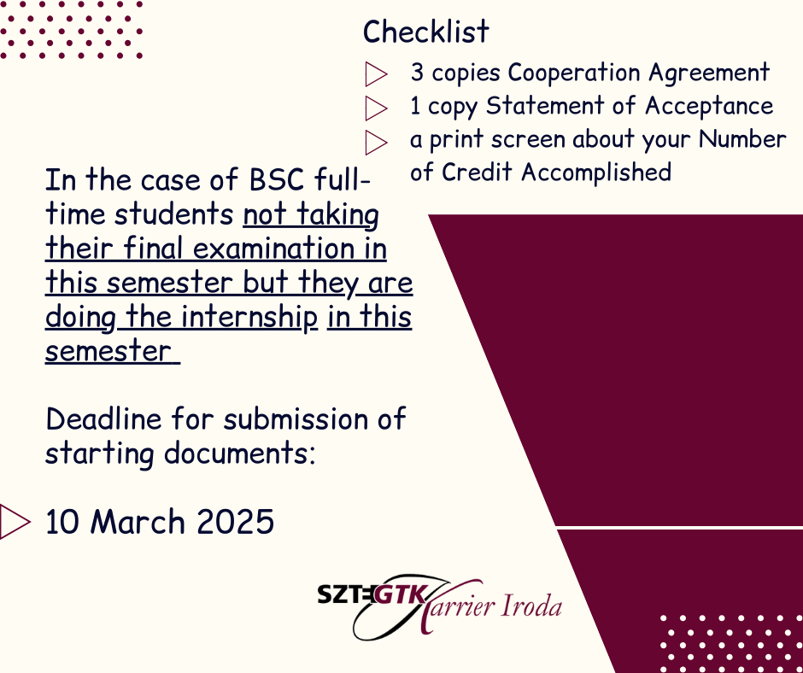
Regular use of sites
Notes:
Regular use of sites
If I'm out of office, I always write about it on CooSpace, so please check it before you write an e-mail for me!
Please follow the reminder posts regularly and exactly.

Slide 8
Deadlines
THE START AND END DATE OF THE INTERNSHIP
SEMESTER | START OF THE INTERNSHIP | THE END DATE OF THE INTERNSHIP
FALL | The internship could be started in Summer complying with the given deadlines | The end date of the internship shall fall in the Autumn semester (from September) and comply with the given deadlines
SPRING | The internship could be started in Winter complying with the given deadlines | The end date of the internship shall fall in the Spring semester (from February) and comply with the given deadlines
Notes:
The compulsory internship shall be completed in the same semester when the student registers for the Internship course. The end date of the compulsory internship must fall in the same semester when the student intends to accomplish the Internship course. If you do the internship in summer, the end of the internship period should fall into minimum 11th September. If you would like to do your internship in summer, you can register for the Internship course in September.
You can check the deadlines in these pages later (about in July):
Our website: https://u-szeged.hu/sztekarrier/hallgatoknak-for/information-in-english
On the CooSpace scene in the GTK General Information Study Affairs Folder.

Slide 9

Common question about the deadlines
You have to do your internship when you register for the internship course. We can’t accept a previously accomplished internship.
Do you accept a previously completed internship?
Notes:
Common question about the deadlines
Do you accept a previously completed internship?
You have to do your internship when you register for the internship course. We can’t accept a previously accomplished internship. If you worked somewhere for 3 months last summer, you can't use it as an internship afterwards.

Slide 10


The place of internship
1. can be proposed by the student.
2. Students that have jobs may perform their internship at their workplaces.
3. If you can't find a company, contact me.
Looking for an internship place is already a rehearsal for real labour market search.
Start searching soon!
Notes:
1. The place of internship can be proposed by the student or
2. Students that have jobs may perform their internship at their workplaces.
3. if you can't find a company contact me.
It is already a rehearsal for real labour market search.
Start searching soon! If you would like to start your internship in this summer please you get in touch the companies as soon as possible, in April or in May.
Follow the Career Office news on the CooSpace scene in the GTK General Information Study Affairs Folder. I usually write about internship positions.

Slide 11

Highered Platform
The aim of Highered Platform is to connect university students with top global recruiters and multinational companies, so it makes the search for internships and job positions much easier.
Create a profile here: https://gethighered.com/
Notes:
We would like to call your attention to a unique opportunity available for GTK students. Our Faculty became an EFMD member in 2020. EFMD is an international non-profit organization of over 500 business schools in the world. The aim of Highered Platform is to connect university students with top global recruiters and multinational companies, so it makes the search for internships and job positions much easier. We post an announcement in CooSpace in the beiginning of every semester with a google form where you can sign up for this opportunity.
This opportunity is open for GTK students. As a next step, we forward the Excel to the contact person. After verification, they will send you an email with the login details. You can keep Highered access until the end of your studies and even as an alumni. You can enter whenever you wish and browse job opportunities.
Feel free to contact us if you have any questions, comments or ideas.

Slide 12


Duration of the Professional Internship
For undergraduate majors in Tourism and Catering
for students beginning their studies from September of 2020 or later: a minimum of 12 uninterrupted weeks of internship/semester. The two-semester compulsory internship can be spent by the same organization (specialized in tourism and catering)
Is it possible to complete the internship in for more than 12 weeks?
The deadlines
have to be met!
Notes:
For students beginning their studies from September of 2020 or later: a minimum of 12 uninterrupted weeks of internship/semester. The two-semester compulsory internship can be spent by the same organization (specialized in tourism and catering).
It isn’t problem if you do the internship at the company for more than 12 weeks but the deadlines have to be met!
A common question is: Is it possible to complete the internship in fewer weeks?
It isn’t possible, you have to do the minimum number of weeks.

Slide 13

Requirements
The academic prerequisite for enrolling in the internship course is the completion of 150 credits for students in the full-time undergraduate program. The academic prerequisite for enrolling in the Internship II. course for students of the Tourism and Catering BSc program is the completion of 175 credits.
If your credit number is not enough, you have to write a request to the Dean on Modulo.
On Modulo/Interfaculty Forms/ Request to the Dean
You have to send this request before you start your internship. (Minimum 2 weeks before!)
Please send me a screenshot if you wrote a request and send me a screenshot if you got the decision!
Enrollment in other courses during the internship is not recommended for student in the full-time programs, but in the Academic and Examination Regulations, enrolling in another 15 credits is not prohibited.
I have 148 credits. Is it possible to start the internship?
Notes:
The academic prerequisite for enrolling in the internship course is the completion of 150 credits for students in the full-time undergraduate program. The academic prerequisite for enrolling in the Internship II. course for students of the Tourism and Catering BSc program is the completion of 175 credits.
A common question is that: I have 148 credits. Is it possible to start the internship?
If your credit number is not enough, you have to write a request to the Dean on Modulo.
On Modulo/Interfaculty Forms/ Request to the Dean
You have to send this request before you start your internship. Minimum 2 weeks before!
Please send me a screenshot if you wrote a request and send me a screenshot if you got the decision!
Enrollment in other courses during the internship is not recommended for students in the full-time programs, but of the Academic and Examination Regulations, enrolling in another 15 credits is not prohibited.

Slide 14
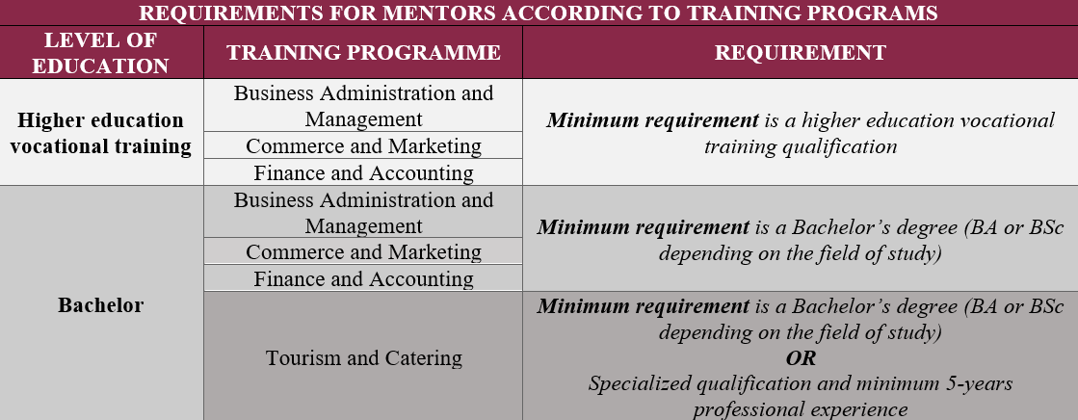
Requirements
The site of the professional internship may be provided by any domestic or foreign economic organization (with legal standing, appearing in the administrative records and with a tax number) that:
- has been in operation for at least two years,
- employs at least one full-time employee,
- had net revenues/a primary budget of over 30 million forints in the year prior to the beginning of the internship, and
- is able to provide a capable and willing representative professionally responsible for the internship. When necessary, a workplace mentor can also be assigned to assist in the professional work of the student directly. If one is not assigned, then the professionally responsible representative shall see to the tasks of mentoring. The individual performing the tasks of mentoring must have an appropriate degree for the educational level of the student.
- Further requirements in the case of the Tourism and Catering BSc program:
  The internship must be spent by an organization specialized in the fields of tourism and catering.
  The mentor shall have at least the same level of qualification as the students’ level of education; or the mentor shall have minimum specialized qualification and minimum 5-years professional experience.
Notes:
These are the requirements for the site of the professional internship.
The site of the professional internship:
- has been in operation for at least two years,
employs at least one full-time employee,
had net revenues/a primary budget of over 30 million forints in the year prior to the beginning of the internship, and
is able to provide a capable and willing representative professionally responsible for the internship.
Further requirements in the case of the Tourism and Catering BSc program:
The internship must be spent by an organization specialized in the fields of tourism and catering.
The mentor shall have at least the same level of qualification as the students’ level of education; or the mentor shall have minimum specialized qualification and minimum 5-years professional experience.

Slide 15
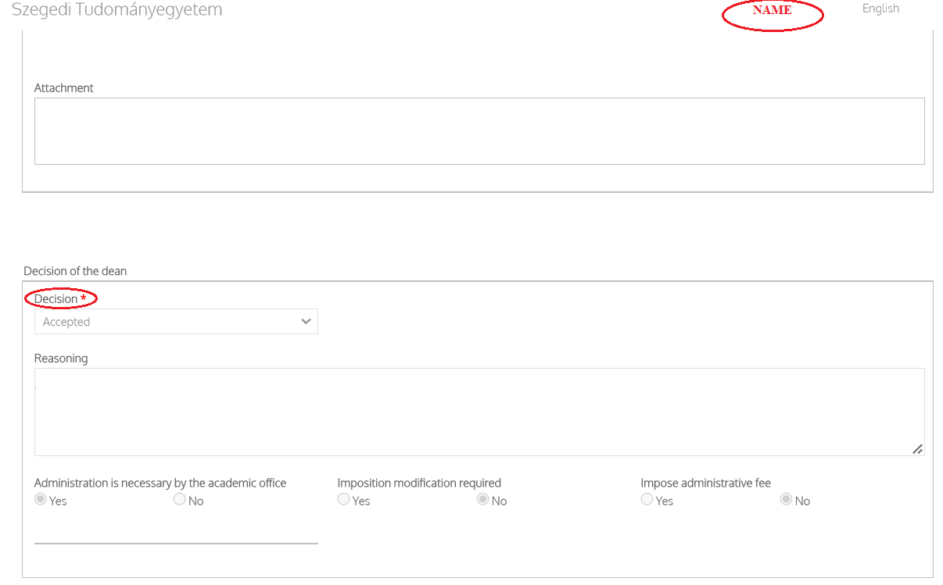
Requirements
If any of the above is not okay with the chosen company, then you have to write a request form directed at the Academic Board!
On Modulo/ Submission/ Place of submission: Interfaculty forms/ name of form: Request form directed at the Academic Board/ Subject: Szakmai gyakorlat/ Internship.
You have to send this request before you start your internship. (Minimum 2 weeks before!)
Please send me a screenshot if you wrote a request and send me a screenshot if you got the decision!
Notes:
If any of the above is not okay with the chosen company, then you have to write a request form directed at the Academic Board!
On Modulo/ Submission/ Place of submission: Interfaculty forms/ name of form: Request form directed at the Academic Board/ Subject: Szakmai gyakorlat/ Internship.
You have to send this request before you start your internship. (Minimum 2 weeks before!)
Please send me a screenshot if you wrote a request and send me a screenshot if you got the decision!

Slide 16
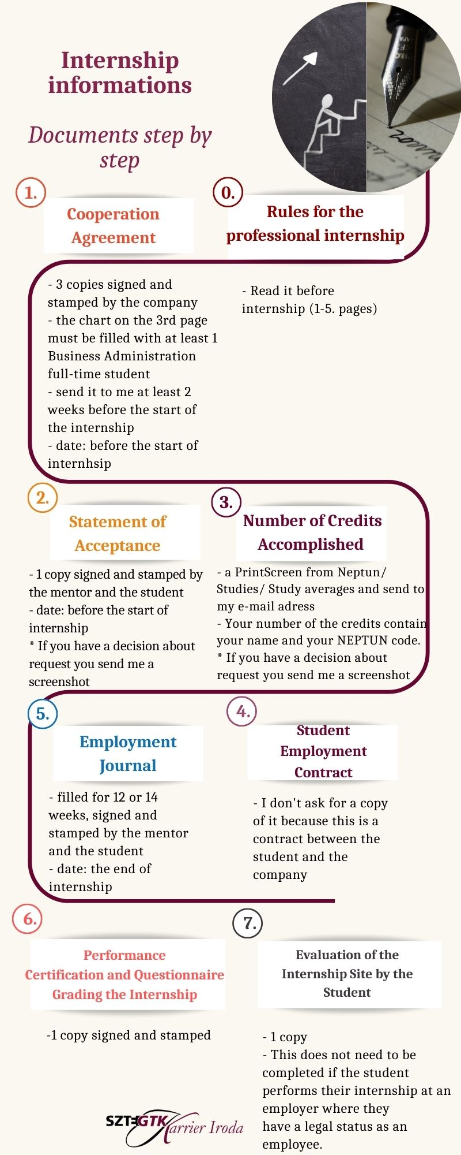
Steps
BEFORE THE INTERNSHIP:
0-4.
AFTER THE INTERNSHIP:
5-7.
Notes:
I made an infographics where you can see how many copies you need, etc.
You can check this on our website or on the CooSpace.
Now, I will speak about some questions that students usually ask about the documents.

Slide 17


0. Rules for the professional internship
What documents do I need to fill out?
Please, read the rules first!
Notes:
A common question is: What documents do I need to fill out?
Please, read the rules first and then, if you have any questions, write an e-mail to me.
Don't be afraid of reading 6 pages. The rest of the pages are the annex.

Slide 18



1. Cooperation Agreement (3 copies)
When will the Dean and Financial Counter-Signatory sign the cooperation agreements?
Can you check if there is a valid cooperation agreement with the company?
The organization doesn’t sign the cooperation agreement. What can I do?
Where should the documents be sent?
Notes:
A common question is: Can you check if there is a valid cooperation agreement with the company?
My answer is yes, of course.
A common question is: The organization doesn’t sign the cooperation agreement. What can I do?
My answer is that the cooperation agreement is compulsory. If the organization doesn’t sign it, please, look for another organization.
A common question is: When will the Dean and Financial Counter-Signatory sign the cooperation agreements?
My answer is: The Dean and Financial Counter-Signatory will sign agreements in about 1 or 2 weeks. Please be patient.
A common question is: Where should the documents be sent?
My answer is: If you spend your internship in Hungary, you can bring your documents in person or you can also send them by post to me. If you spend your internship abroad, we accept your documents scanned.

Slide 19

2. Statement of Acceptance (1 copy)
The Statement of Acceptance for majors in Tourism and Catering students is different!
Should this document be sent to Gabriella Maczkó or Barbara Masa?
Which credit value to look at?
The Number of Credits Accomplished.
Notes:
The Statement of Acceptance for majors in Tourism and Catering students is different!
A common question is: Should this document be sent to Gabriella Maczkó or Barbara Masa?
My answer is: to me.
A common question is: Which credit value to look at?
My answer is that the Number of Credits Accomplished.

Slide 20
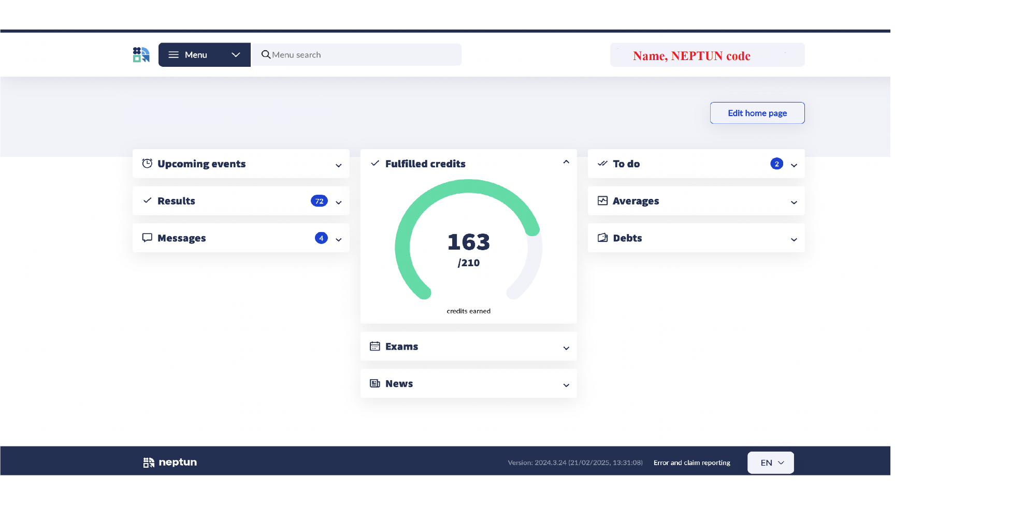
3. Number of Credits Accomplished (1 copy)
How to send a Number of Credits Accomplished?
Do I need to ask Gabriella Maczkó for a certificate?
You don't need, I accept this number of credit accomplished.
Notes:
A common question is: How to send a Number of Credits Accomplished?
My answer is: I attached an example screenshot. It contains your name and your NEPTUN code.
A common question is: Do I need to ask Gabriella Maczkó for a certificate?
My answer is: You don't need, I accept this number of credit accomplished.

Slide 21
4. Student Employment Contract (It doesn’t need to be sent)
Why is this document among the downloadable documents if it doesn’t need to be sent to you?
It is a help for companies that don’t have their own student emloyment contract form.
Notes:
A common question is: Why is this document among the downloadable documents if it doesn’t need to be sent to you?
My answer is: This is a help for companies that do not have their own student emloyment contract form.

Slide 22
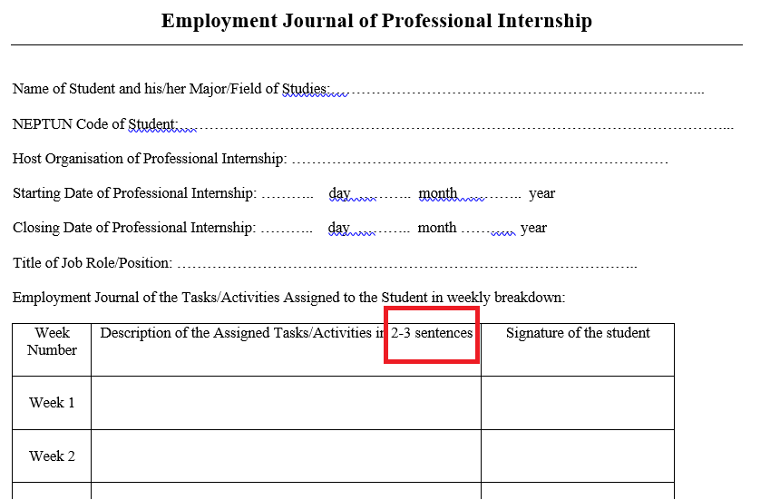
5. Employment Journal (1 copy)
I do the internship at my workplace. What employement journal should be filled out?
Everyone should fill out the same employment journal.
Do I have to send you the employment journal every week?
No, just fill it out every week and send it to me when you finish your internship.
Notes:
A common question is that: I do the internship at my workplace. What employement journal should be filled out?
My answer is: Everyone should fill out the same employment journal.
A common question is: Do I have to send you the employment journal every week?
My answer is: No, just fill it out every week in 2-3 sentences and send it to me when you finish your internship.

Slide 23
6. Performance Certification and Questionnaire Grading the Internship (1 copy)
Which Performance Certification and Questionnaire Grading the Internship must be filled out?
Relevant to your major(TAC)!
I have sent my documents to you. Do you send me an e-mail when you receive them?
Notes:
A common question is: Which Performance Certification and Questionnaire Grading the Internship must be filled out?
My answer is: Relevant to your major!
A common question is: I have sent my documents to you. Do you send me an e-mail when you receive them?
My answer is yes, every time.

Slide 24
7. Evaluation of the Internship Site by the Student (1 copy)
Why do I need to complete this document?
You can help your fellow students with your opinion.
Notes:
A common question is: Why do I need to complete this document?
My answer is that you can help your fellow students with your opinion.

Slide 25

Copy the documents for yourself!
The mail size that can be received at masa.barbara@szte.hu is 10 MB, so reduce the file size before sending. For example: file compression, file cutting or rational resolution scanning.
If anything has changed about your internship, write me an e-mail! (I understand English better than I speak it.)
Be aware of your mentor’s vacation/holiday. Don't send your documents late because of it.
For practical questions, always contact me first!
Don’t deliver all the documents at once! (starting, ending)
The deadlines have to be met!
Notes:
Here is some useful information.
Copy the documents for yourself!
The mail size that can be received at masa.barbara@szte.hu is 10 MB, so reduce the file size before sending. For example: file compression, file cutting or rational resolution scanning.
If anything has changed about your internship, write me an e-mail! (I understand English better than I speak it.)
Be aware of your mentor’s vacation/holiday. Don't send your documents late because of it.
For practical questions, always contact me first!
Don’t deliver all the documents at once! (starting, ending)
The deadlines have to be met!

Slide 26


Thank you for your attention!
masa.barbara@szte.hu
+36 30 121 13 53
6722 Szeged, Vitéz street 17. (Career Office;
Office 8)
Notes:
Thank you for your attention!
If you have any questions, you can write an e-mail me to masa.barbara@szte.hu.

